Slide 1
Three Data Conversations Using the LaunchBoard
August 3, 2018

Slide 2
Jenni Abbott Modesto Junior College
Institutional Effectiveness Office
Includes two Research Analysts
Oversight of Strong Workforce
Competitive CTE proposal development process
Goal is to make data usable
Technical Assistance
Individual proposal support

Slide 3
Using LaunchBoard Data
Program Development
Faculty training in LaunchBoard navigation
Considering data from other colleges
Center of Excellence industry scans
What happens when students complete?
Did they find a job in a related field?
Do they earn a living wage?
Did the training prepare them?
Notes:
Launchboard navigation: discussions about data discrepancy → faculty look more closely at what they think they know. Opportunity to correct reporting errors.
Faculty are thinking about what happens after their programs. Focused on programs and employment instead of course success.
Program development: Where are similar programs at other colleges? How are their completion and placement rates? Contacts for development
Center of Excellence: Custom reports in program areas of interest. CoE Website for multiple reports.
Employment questions: Will this new program or program improvement lead to improved outcomes?

Slide 4
What is your experience?
When you use data for decision making, what data do you look at?
1
Where do you get this information?
2
What is an example of how that information changed your decision?
3

Slide 5
Data Don’t Drive
They help to answer questions

Slide 6
Making Data Useful
Data examination needs to have structure, based in specific questions that are meaningful to the asker:
Are our students able to improve their lives?
Did all students do equally well?
Why did our students do well?
What made it hard for students to do well?
What can the college do to foster equitable success?

Slide 7
Modesto Junior College Welding
41% increase in earnings
70% of students attained the regional living wage
83% of students are employed in a job similar to their field of study
Notes:
Determining the source of information is critical – these questions are important to answer first. But the conversation can’t stop here.
Provide opportunity for participants to ask their where questions.

Slide 8
WHERE?
Where did this information come from?
Is it reliable?
Is it representative?
Notes:
Determining the source of information is critical – these questions are important to answer first. But the conversation can’t stop here.
Provide opportunity for participants to ask their where questions.

Slide 9
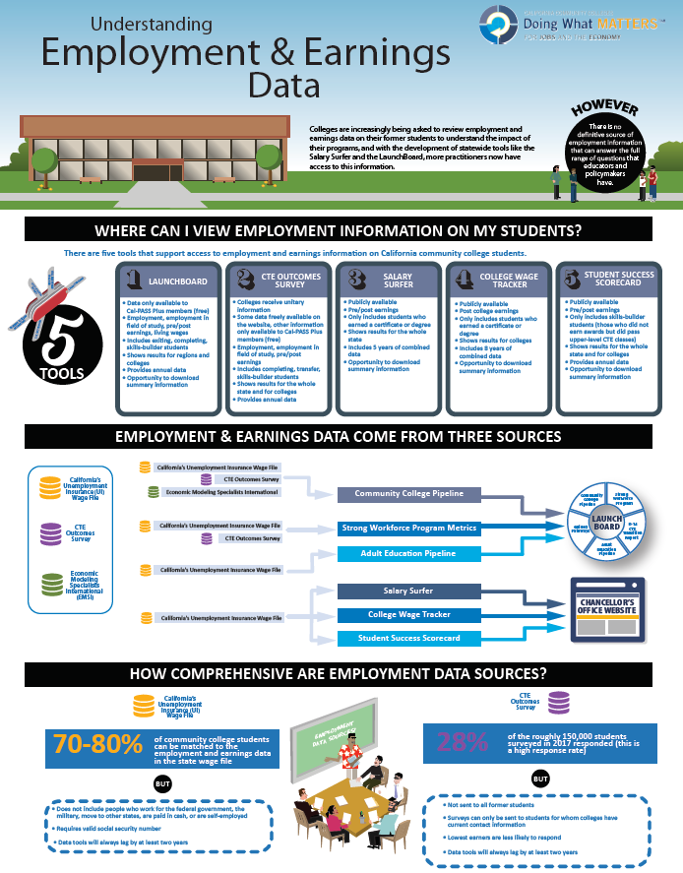
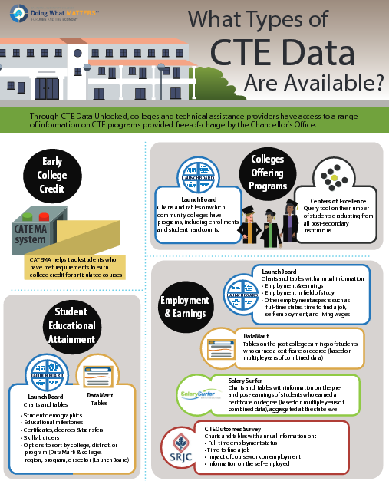

Slide 10
WHY?
What problem are you trying to solve?
What would success look like?
Which available metrics could help you evaluate whether you are solving the problem?
Notes:
If you don’t have a research question, the information is just a nice to have.
Provide opportunity for participants to list some of the problems they are trying to solve.

Slide 11
PROBLEM
How can we accommodate the number of students who are currently on wait lists for welding classes?
Is there sufficient industry demand to employ the number of students who want welding training?
GOAL
Increased employment rates, earnings, and a degree or certificate.
METRICS
What is the demand for welders in our region?
How many students are being trained in our region?
What are student employment and earnings outcomes after they leave college?
Notes:
Employed in 2nd/4th fiscal quarter
Median change in earnings
Living wage
How can we combine analysis of outcomes data (Launchboard) and institutional data (scheduling, wait lists, completion rates) to improve programs?
Do we have strong relationships with multiple employers to develop internships, etc.?
Job closely related (insufficient data) → are completers using these skills in multiple fields?

Slide 12
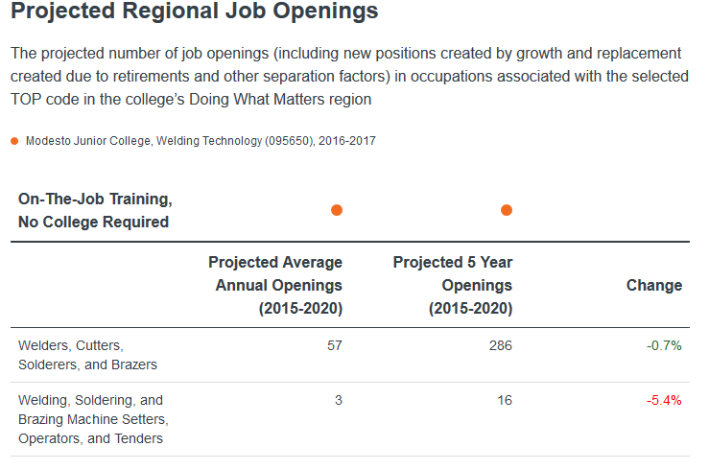
Notes:
EMSI says there are a number of openings
Do we share employment projections with students. Will they be more likely to complete programs if they know higher level skills are more in demand?

Slide 13
Notes:
But lots of colleges are training students
Professional relationships with local employers are critical to student job placement.
83% of CTEOS responders have a job in a closely related field

Slide 14
First Order Questions
Are there other occupations that use welding skills in our region?
1
Will there be enough jobs for all the students taking welding courses?
2
Notes:
Kathy poses the question
Jenni provides contextual information (working on this)

Slide 15
Second Order Questions
Who was part of the program?
Were they able to make progress in the program?
Whose lives got better?
Were improvements equitable?
Notes:
In order to contextualize longer-term outcomes, it’s helpful to know who is in the program and how far they got.
Demand for program is high – wait lists.
Completions are low → students take jobs w/in the first several weeks of a semester
We also see students break up enrollment. Many return after a semester or two away for additional skills. Can we modularize this in a better way?

Slide 16
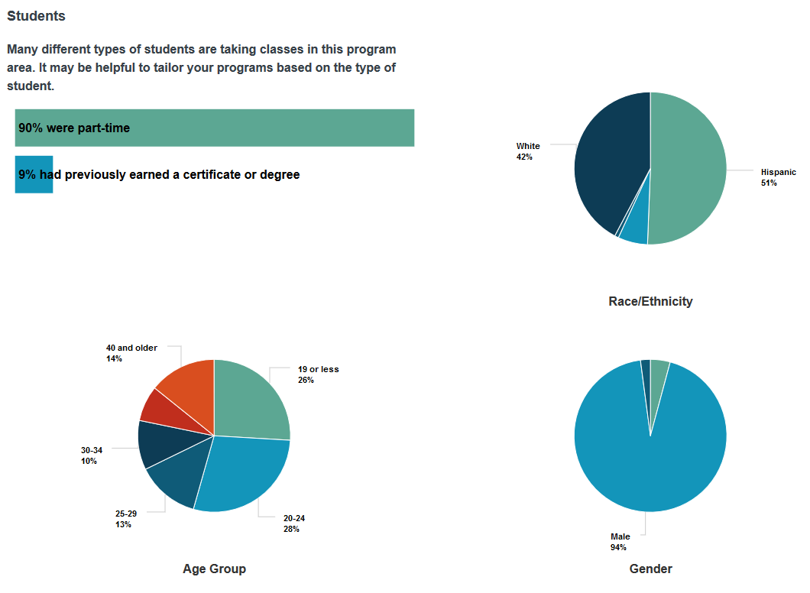
Notes:
The program is serving a large number of younger, Hispanic students who are enrolled part time

Slide 17
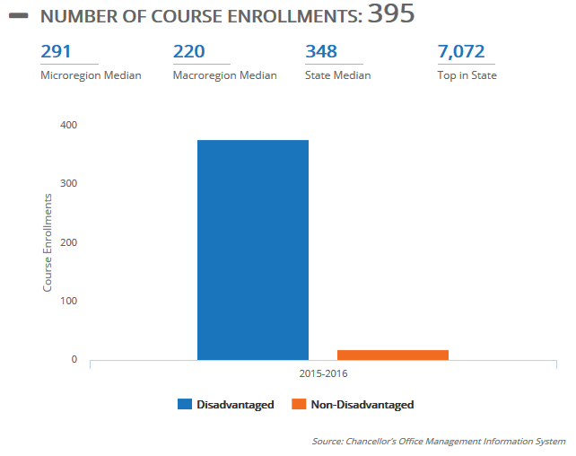
Notes:
Most of these students are economically disadvantaged.
Jenni:
Welding skills lead to relatively high wages in a relatively short amount of time.
Many students exit programs in the first semester for a job and return later for additional skills.
Our Accelerated Career Training (ACT) program provides case-management support for students in CTE programs. Students enroll in intensive courses for completion w/in 6-12 months.
One possibility is that students support themselves with welding jobs while they complete transfer programs.

Slide 18
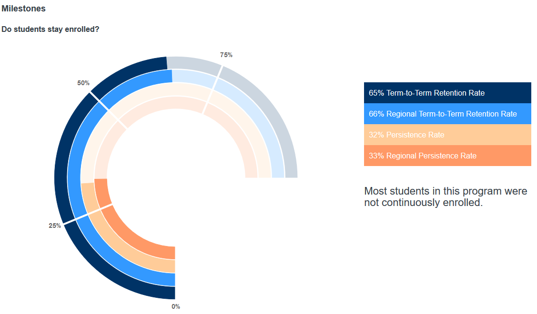
Notes:
The program has very few students enroll for three terms.
Jenni posits some explanations for why.
Students go to jobs requiring welding skills after the first several weeks. Many return later for additional skills.

Slide 19
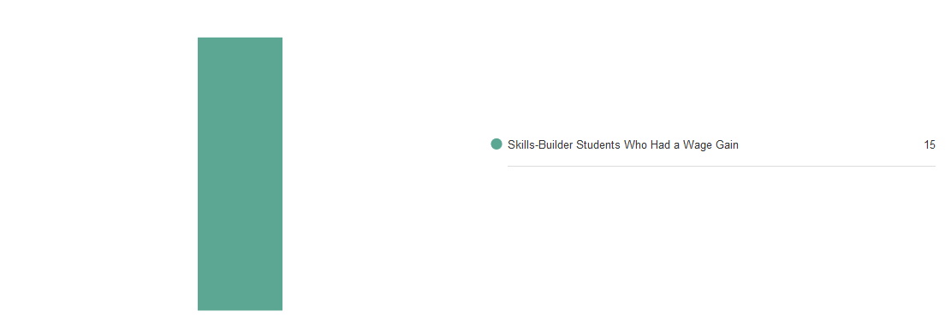
Notes:
Students almost never complete the program—many students don’t attain skills-builder status and not all get an earnings gain.

Slide 20
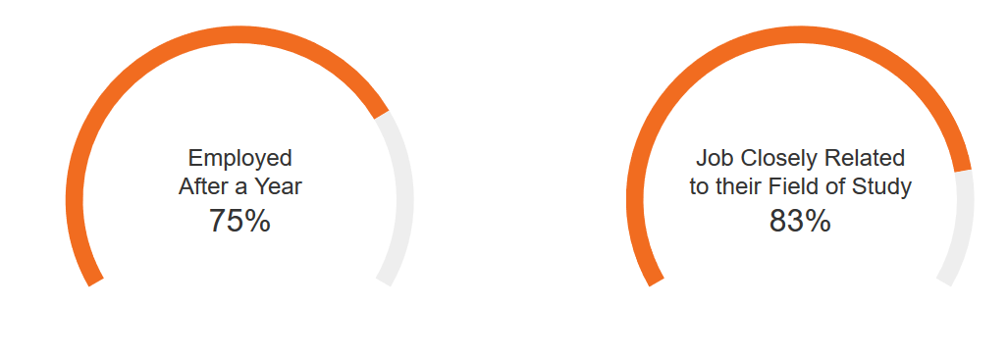
Notes:
Solid employment outcomes

Slide 21
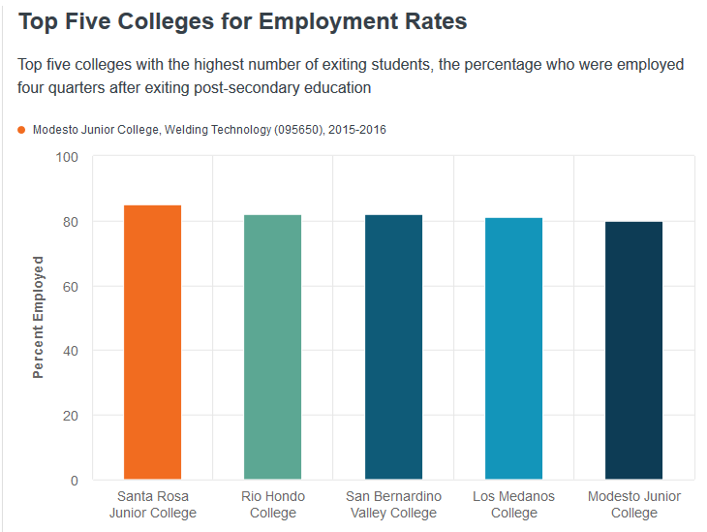
Notes:
Among the strongest in the state
Jenni:
The Accelerated Career Training (ACT) program supports students through an aggressive, intensive completion plan
Program faculty have developed strong partnerships with local industry:
Stanislaus Manufacturing & Maintenance Joint Apprenticeship Program
Faculty are also currently working in the industry

Slide 22
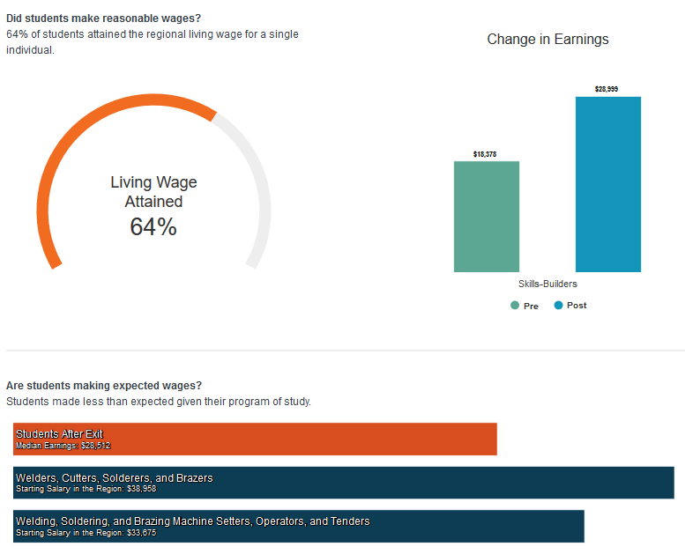
Notes:
Students aren’t making as much as the labor market data indicates welders make in the Central Valley. Jenni or Nora provide context.
We look at entry-level pay rather than median as it takes approximately 3 years of experience to reach median. From that view:
The starting wage in Stanislaus County is $30.534.40 (welders, cutters, solderers, and brazers). We use the lowest 10% of welding wages because we have many small businesses, and low socio-economic indicators.
Starting wage is $24,148.80 for welding, soldering, brazing machine-setters, operators, and tenders.
A simple average of the expected entry-level wages of the two is : $27,341.60 → our earnings are $28,999

Slide 23
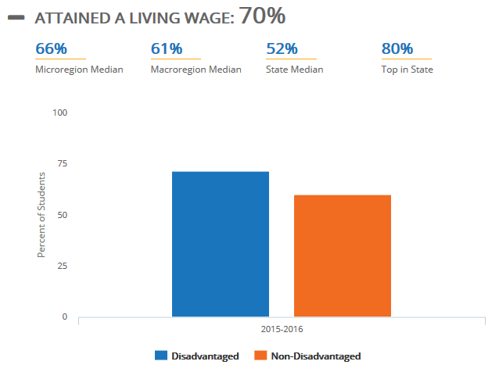
Notes:
Still, economically disadvantaged students do comparatively well (this often is not the case).

Slide 24
Third Order Questions
How did this program fit into students’ longer-term plans?
1
What’s working?
2
What’s getting in their way?
3
Notes:
We are now looking at the students who return for additional training and those who transfer.
Job demand at relatively good wages takes students out before program completion. We would like to find a way for students to earn a degree or certificate before they exit.

Slide 25
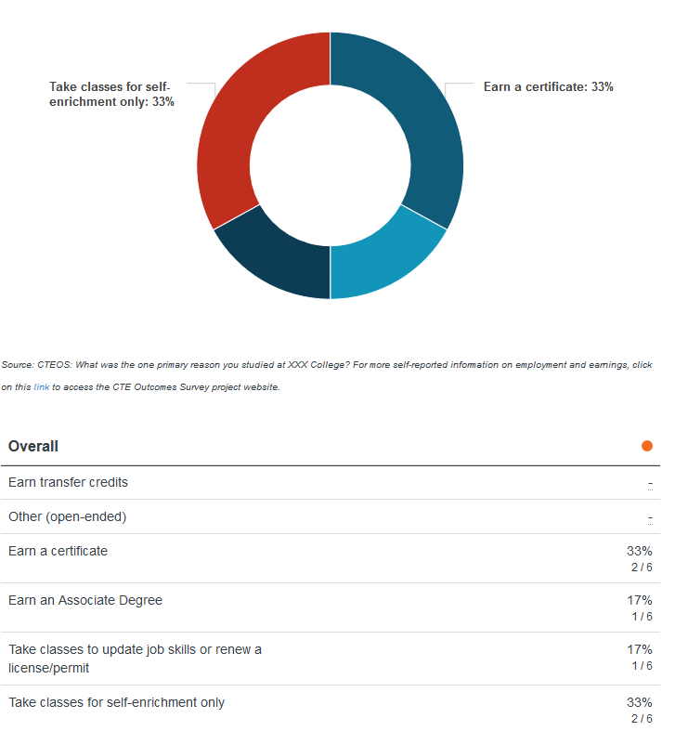
Notes:
Half of students wanted to earn a bachelor’s degree, but another quarter were only taking welding for fun.
Students exit the program for jobs without completing an award and return later for additional skills.
Program faculty posit that with the number of economically disadvantaged students at MJC, welding may be a means of support as students complete degrees or transfer in other areas.

Slide 26
Fourth Order Questions
How can we do more of what is working?
1
How can we improve outcomes?
2
Notes:
Kathy poses the question
Jenni provides contextual information (working on this)

Slide 27
Hands On Work
Working in small groups, use the LaunchBoard to look up information that could help to answer one of the following questions about another program:
Is marketing, scheduling, and curriculum responsive to current student populations?
What factors make it easy or hard for students to stay continuously enrolled?
Are students able to make a reasonable living after taking classes?
Or, pose your own research questions.

Slide 28
Reflection
What did you discover during this process of digging into the data?
What additional sources of data do you want to seek out?
What additional resources do you need to use the information you have?

