Slide 1
What CTEOS is Learning about Coronavirus Employment Impacts for former CTE students Slide deck at cteos.org (CTEOS COVID Employment Impacts ) The California Community Colleges Career & Technical Education Employment Outcomes Survey
Amil Gehrke
Notes:
Amil Gehrke currently directs the survey on behalf of the Chancellor’s Office, and has a background in K-12 educational research.

Slide 2
Agenda:
What is the Career Technical Education Employment Outcomes Survey (CTEOS)?
What is the CTEOS Covid-19 Employment Impacts Survey?
Findings from the Employment Impacts Survey.
Discussion

Slide 3
What is CTEOS?
CTE Employment Outcomes Survey (CTEOS) is an annual statewide study to assess employment outcomes of students who have participated in career technical education (CTE) coursework at California Community Colleges.
All 114 California Community Colleges Participate.
Survey administered by email, text and phone (self reported data).

Slide 4
Who participates?
Completers:
Students who received a vocational/CTE award that is Chancellor’s Office approved and are not enrolled or are minimally enrolled each semester the following year.
Terminal Certificates:
Students who received a vocational/CTE award of at least 6 units that is not Chancellor’s Office approved and are not enrolled the following year.
Skills Builders:
Students who completed 9 units that are SAM coded and have not received an award, and are not enrolled the following year.

Slide 5
2020 Cohort
Approximately 150,000 for-credit possible respondents
Approximately 10,000 noncredit possible respondents
2020 possible respondents had their last enrollment during the 2017-2018 school year, where not enrolled during the 2018-2019 school year and were surveyed during the 2020 calendar year.
Survey normally runs from January till October with a 30% response rate.

Slide 6
What Type of Data is Collected?
Both quantitative and qualitative data is collected, including:
Satisfaction with education
Job search length, outcome, and current employment status
If their employment is related to their field of study
Pre-and-post employment hours and wages
Much more!

Slide 7
Where to find CTEOS Data?
CTEOS Website: https://cteos.santarosa.edu/visualizations
LaunchBoard Community College Pipeline (employment): https://www.calpassplus.org/LaunchBoard/Community-College-Pipeline.aspx (Employment in field of study also on SWP and SSM)
Colleges can request their data: https://cteos.santarosa.edu/request-data

Slide 8
COVID Impacts on 2020 CTEOS Cycle
Additional Data elements added to the survey for respondents:
COVID Impacts on Employment Status
Pre and post COVID Wages, Hours Worked, Employment in Field of Study
Survey window expanded till the end of October with survey data being release the end of November.
Both the 2019 survey instrument and the 2020 survey instrument are available at https://cteos.santarosa.edu/information

Slide 9
Questions About CTEOS

Slide 10
2020 COVID EMPLOYMENT IMPACT SURVEY
This is a separate instrument and administration from the 2020 CTEOS survey.
Was administered July 8th 2020 to August 18th 2020
Only was sent by email to addresses on hand
Included former CTE students who met the criteria for 2017, 2018, or 2019 survey cycles (Last enrollment was 2014-2015, 2015-2016, 2016-17 respectively).
Data is available now: https://cteos.santarosa.edu/2020-cteos-covid-survey-response-rates

Slide 11
What questions were asked:
Current employment status
Impacts of COVID on employment including status, wages, hours worked.
If currently a student and type of institution attended
Interest in returning to community college
Gig worker status
Pre-and-post COVID wages, hours, and if employment is in field of study
Perception of job security

Slide 12
Response Rates
21,328 responses collected
488,225 total possible respondents (4.37% response rate)
459,519 possible respondents had at least one email on file (94%)
197,578 had more than one email (43% of those with emails)
255,736 email addresses ended in “.edu” (39% of all emails)
Bounce rate was over 30% (190,000 email addresses) and beyond the technical capabilities of the system.

Slide 13
Respondent Demographics
Notes:
Using IPEDS ethnicity STD10
White respondents are over-represented by 3.25% points
When looking at a normal CTEOS distribution, Whites are over represented by 1.39% points.

Slide 14
Respondent Demographics
Notes:
Gender SB04
Females where more likely to respond than males.
In a normal CTEOS distribution, 52% of respondents are female. However over 58 of respondents who reply email are female and the difference is made up by the phone center.

Slide 15
Completers and Skills Builders
Notes:
In normal CTEOS distribution, completers make up 34.6% of respondents.

Slide 16
Questions About The COVID Survey

Slide 17
Current Employment Status (All Respondents 21,283)
Notes:
About 78% were unemployed and 12% were furloughed

Slide 18
Employment Status Completers
(8,798)
Employment Status Skills Builders
(12,485)

Slide 19
Were you employed on March 11, 2020, the date that the Novel Coronavirus Disease, COVID-19, was declared a pandemic?
 | Unemployed Completers | Unemployed Skills Builders | All Unemployed
Yes | 61.4% (10% of Completers) | 57.7% (13% of Skills Builders) | 59.0% (12% of Respondents)
No | 38.6% | 42.3% | 41.0%
Total Count | 1429 | 2884 | 4313

Slide 20
What is your current primary source of income? Those who lost employment after COVID (2,543)

Slide 21
Has the COVID-19 Pandemic impacted your employment in any way? (19,032)

Slide 22
Most Common Answers (select all that apply):
17% = Switched to telecommuting
11% = Furloughed (still employed but hours have been reduced, including working zero hours a week while still being employed)
11% = Lost weekly hours
10% = Job Duties Significantly Changed
10% = Other
8% = I have been seeking new employment but my job search has been impacted
8% = I lost my job
6% Temporary lay off

Slide 23
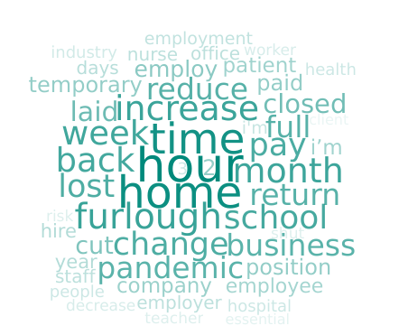
10% Selected Other:
Notes:
Following Words Were Removed: work, working, covid-19, job

Slide 24
In their own words…
Have to clean counters after every costumer and other added duties so work is now more exhausting
10 out of 16 staff lost their job. I am one of the 6 still employed.
As an exempt employee, I am expected to perform the job of 2 hourly employees including mine.
As a Registered Nurse, more concerns from having potential covid patients, greater fear with everyone experiencing a fever, cough, or chills
Been feeling very stressed lately

Slide 25
In their own words…
Before the pandemic, most of my income was from event & portrait photography work but I am on furlough with the companies I work for. My education with SDCE prepared me to transition quickly to a new industry and a different job which has kept me employed.
I help people create online courses (partly using skills I gained at Cerro Coso). More people need to create online courses now, so my business has increased. I realize how very fortunate I am.. not only for myself, but also to be able to help others survive and thrive during these challenging times. THANK YOU for the great education and skills you taught me!

Slide 26
Pie Chart Percent of How closely related to your field of study was the job you had before the COVID-19 pandemic? (3,803)
Pie Chart Percent of How closely related to your field of study is your current job? (15,757)
Notes:
Very close -- my job was in the same field as my coursework and training
Close -- I used what I learned in my coursework and training even though I did not work in the exact same field
Not close -- my coursework and training were not at all related to the job

Slide 27
How closely related to your field of study was the job you had before the COVID-19 pandemic?
Currently Unemployed (1,436)
Currently Employed (2,366)
This question was displayed to all who lost their jobs, changed jobs, changed industry, job duties or title have significantly changed or have been unable to work due to health concerns
Notes:
84% of completers and 80% of skills builders saw no change. 8 of completers moved more or less similar. 10 of skills builder moved to more similar and 9 moved to less similar.

Slide 28
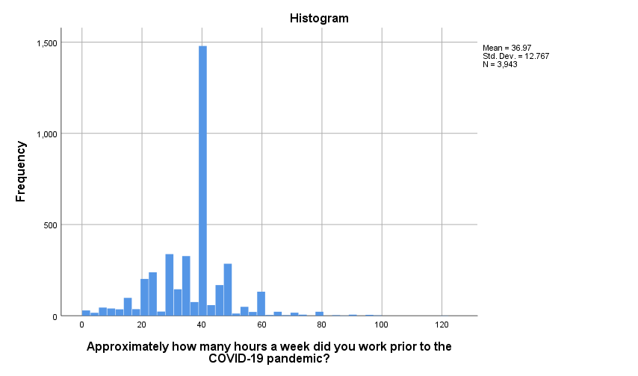
Pre-COVID Weekly Hours Only respondents who were employed and reported an event
Notes:
75% (25% part time) of respondents reporting working fulltime currently. We are showing only those that had hours both before and after COVID. Respondent had to answer both pre and post covid hours. 1467 (37) of works.

Slide 29
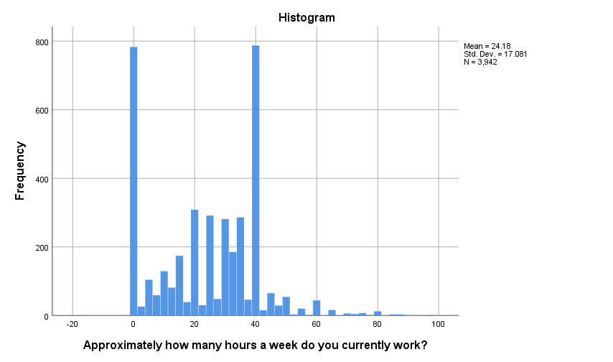
Current Weekly Hours Only respondents who are employed and reported an event
Notes:
Of those that qualified for the question, 71% of respondents reported working full time before COVID. 71% of zero hour workers reported being furloughed, 13% of 0 hour works are self employed, 10% consider themselves employed. If you dropped all the zero’s the mean is 30.07 hours a week. Respondent had to answer both pre and post covid hour. 771 total people answered 0 and 780 answered 40.
If you break these out be skills builders and completers, More completers are employed 40hrs than 0hrs than skills builders and more skills builders are working 0hrs than fulltime.

Slide 30
Mean Hours Worked a Week
Means: Those working close or very close to their field of study lost 3.6 less hours than those not close.
Means: Completers lost 2.47 hours less than completers
Notes:
Current job was primary, if missing previous job was imported. Close and Very close combined.

Slide 31
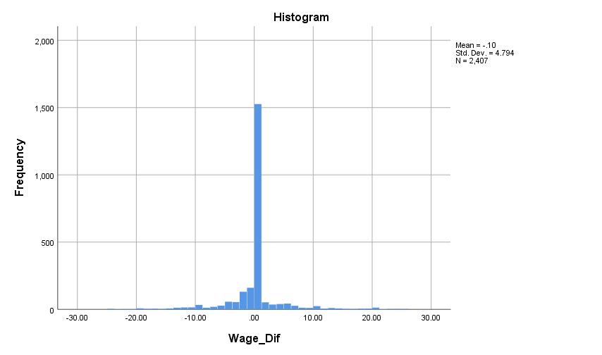
Wages
←Gain | Loss →
Notes:
Valid wage is considered between 7.50 and 500
Hourly wage was calculated at 40 hours for full time and actual hours for part-time.
Pre Covid wage Minus Covid Wage 20-10=10
Completer .30
Skills Builder .08

Slide 32
I am worried about my current job security (I may be laid off or have my hours/wages reduced)
Notes:
60% of completers disagree and 55% of skills builders disagree.
41% of completers strongly disagree and 35% of skills builders strongly disagree.
20% of both skills builder and completers somewhat disagree.

Slide 33
Discussion
Learn more or request your data at https://cteos.santarosa.edu/2020-cteos-covid-survey-response-rates
Contact: agehrke@santarosa.edu

